Slide 1
Spot Sale through Mobile Apps.
User Requirement Specification (URS)

Slide 2
Use Case Description
Use Case Name: TBL- Spot sales Management Date:05-10-2015
Version: 2.0
Primary Actor (s) : PSR Secondary Actor (s) : DBH Operator
PSR will Input Sub-Route Wise Sales Or Input Distribution house Office Sales which Distributor use Delivery Module.
Firstly, PSR will enter in Spot sales, After entering in Spot sales they will get available sub route. Meanwhile, they will get a summary where Sub route wise sales summery.
Secondly, PSR select Sub route and its going to order summary , PSR will click on order menu and add order by select brand and SKU. PSR will input case & PCs as SKU quantities and then, system will automatically the total value. Afterward, PSR will add these quantity, which will show in order Summary. In order summary, PSR will also edit or discard SKU quantity.
Finally, PSR will view final order summary and save this order for particular Sub route .

Slide 3
Start
Spot sales Taking Workflow
Log in
Spot Sales
Select
Sub Route
Sub Route sales Input
Save and Send To DBH
End

Slide 4
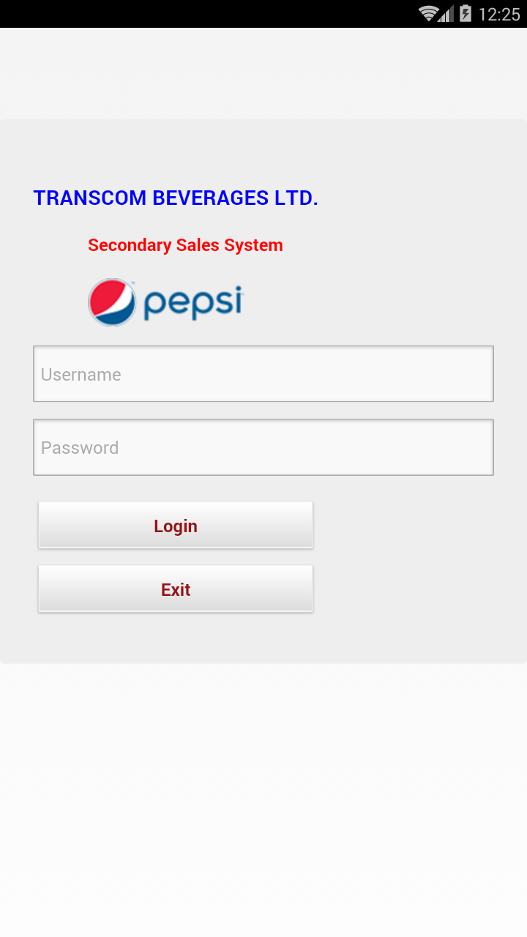
Login User Interface
To login into the system Internet connection must be there.
User need to give their individual User Name & Password to login into the APK system.

Slide 5
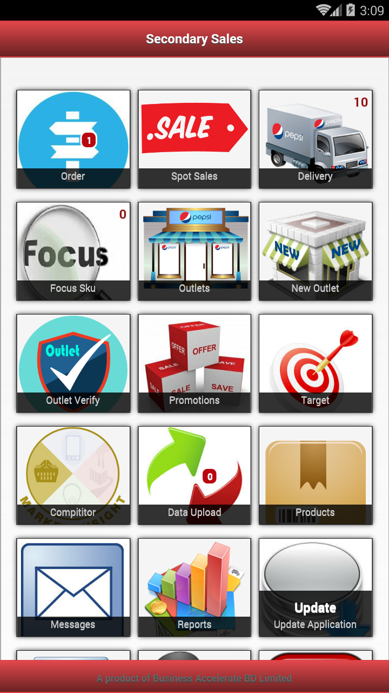
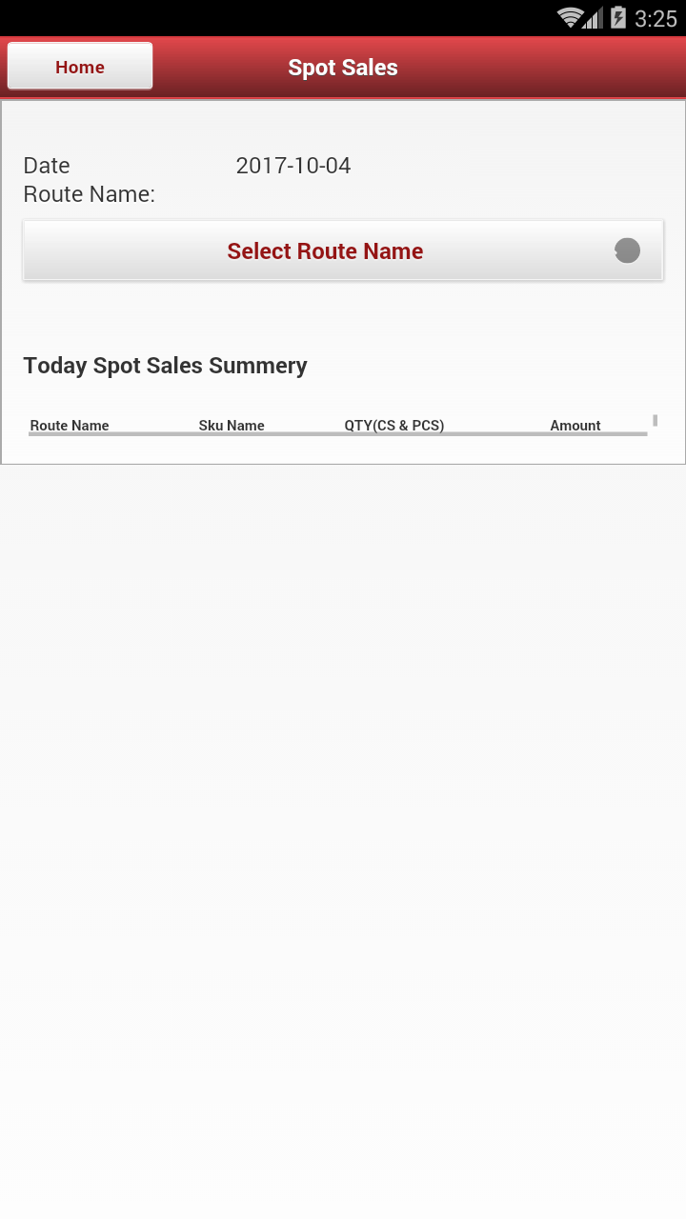
User View after Login
User need to click the “spot sales option” to know about the pre-defined route – Figure 1
After clicking the “spot sales ” user can see the SubRoute list and current Date – Figure 2
Figure 1
Figure 2

Slide 6
Sub route Selection & Order Creation
Selecting the Sub route name user can sales for that individual Sub route.

Slide 7
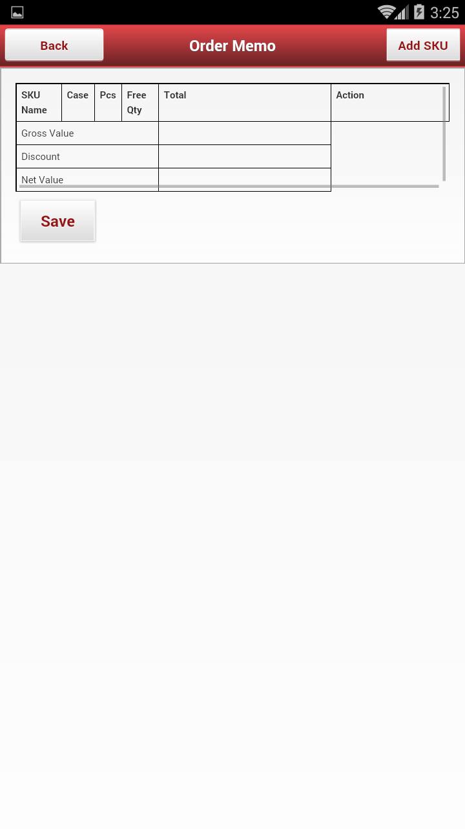
Sub route Selection & Order Creation
After clicking the “sub route “ button this view will be opened and the user can create order by clicking the “Add SKU” Button.

Slide 8
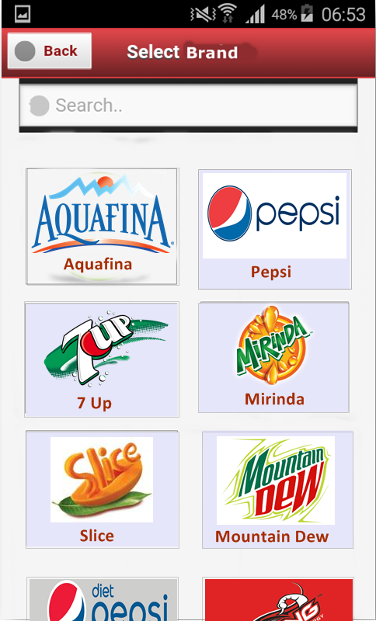
Select Brand
To make an order PSR need to click on the Brand that is ordered by Outlet.
After clicking on the Brand, PSR will see the product list.

Slide 9
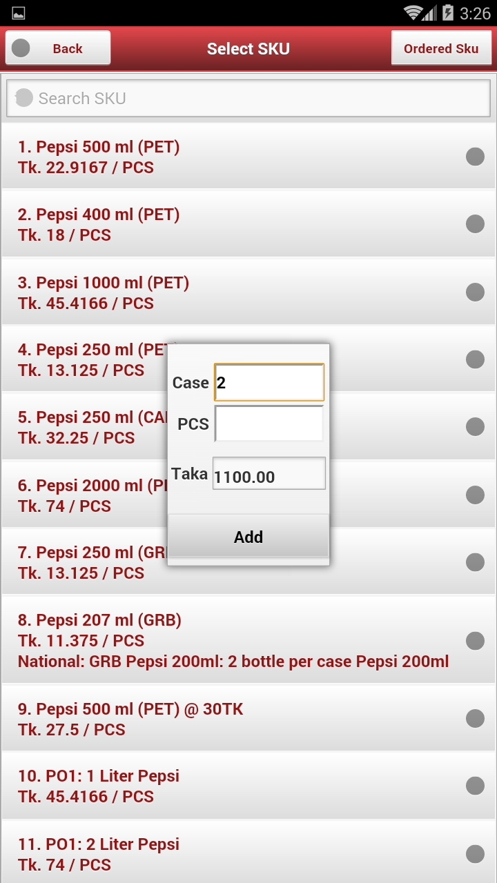
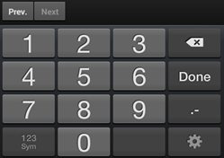
Selection of Product & Qty.
When the PSR will press the Add option the list of SKU’s will be shown. The PSR can also search any SKU from the search option.
The promotion offer will be shown under the individual product in color.
While PSR will select any individual SKU, the Add option will be viewed & in the add option, S/he will only input quantity as Case & Piece wise. After providing quantity input, total value will automatically calculate and show.

Slide 10
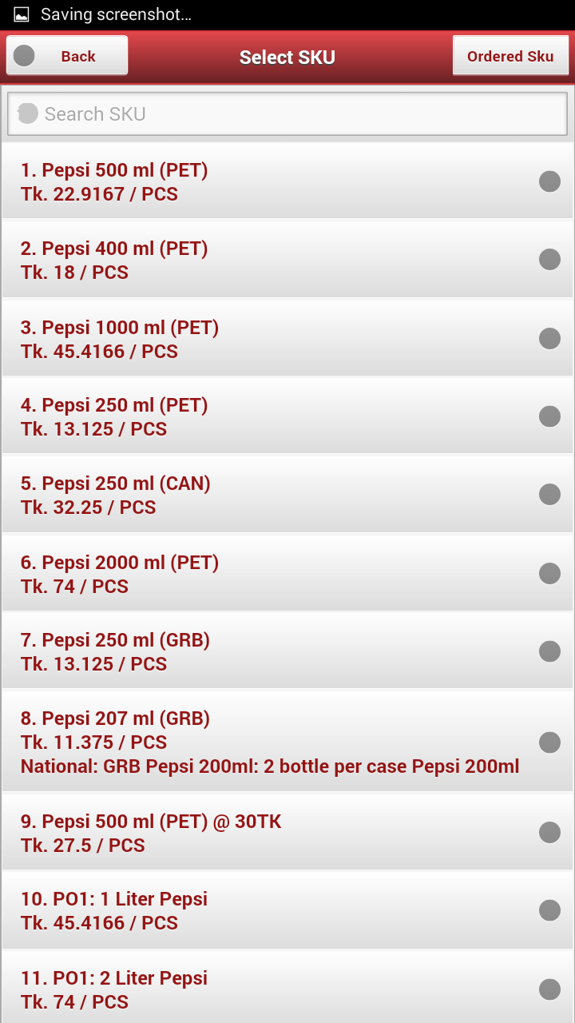
View after Order Confirmation
The selected product will turn into a Specific color.
PSR can select multiple product by clicking on Brand.
To see the ordered product details, PSR need to press the “Back” Button

Slide 11
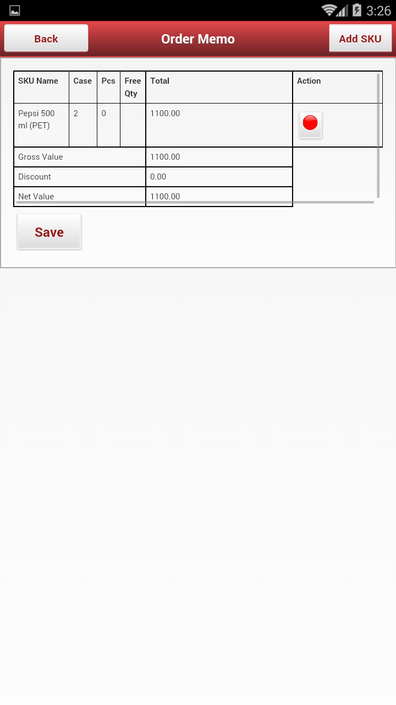
Ordered Product Details - Memo
By clicking the “Red Button” the user can cancel the order of specific SKU.

Slide 12
Order Summary
This is the Summary Interface.
The SKU name, Sku Qty , Total Ordered amount shown in this Interface .

Slide 13
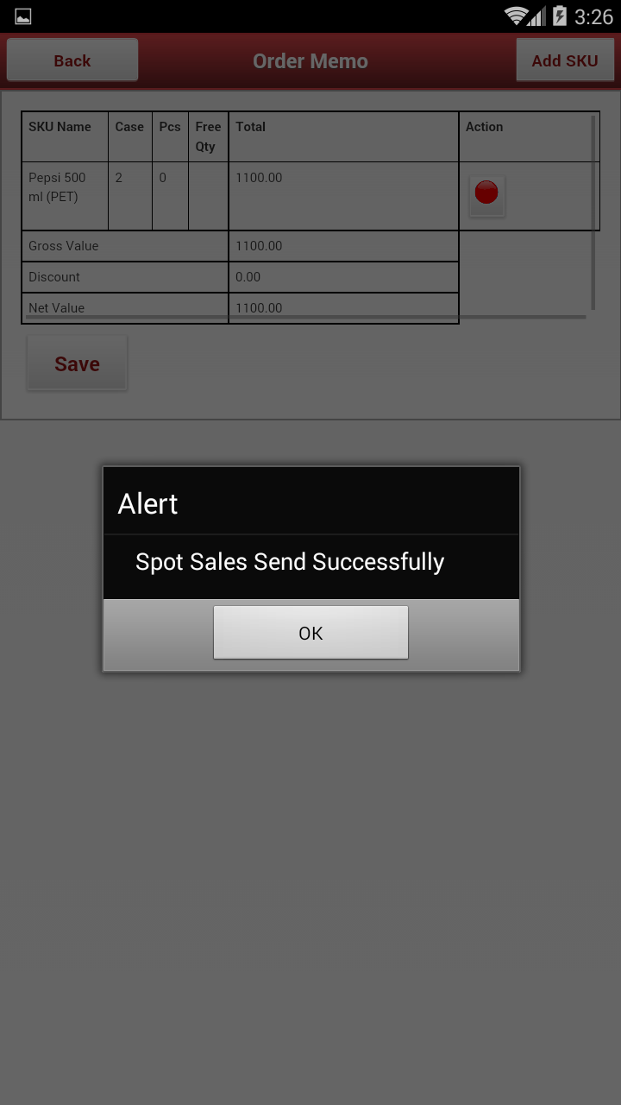
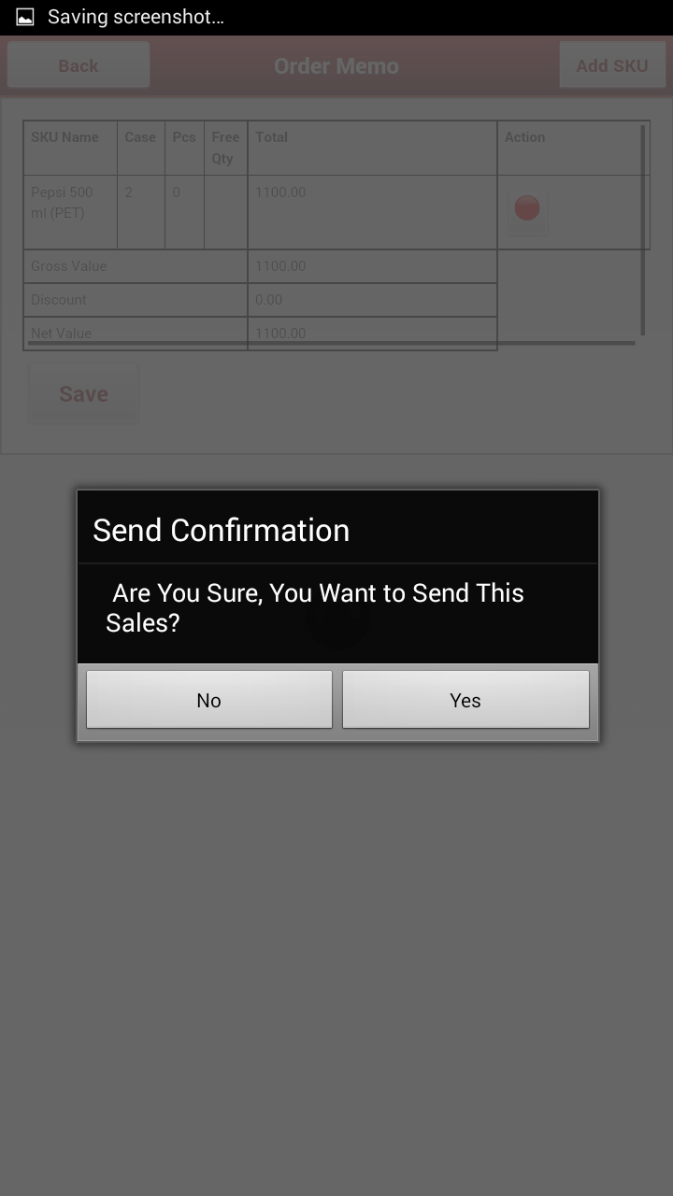
Order Save
After click “Save” an alert box show to confirm a order.
If click “Yes” it will save ,if click ”No” order will not save.

Slide 14
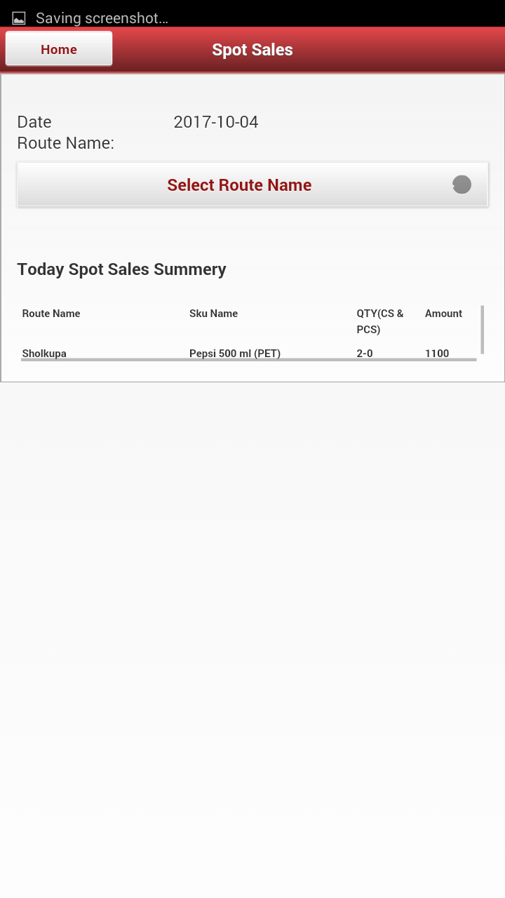
Spot sales Summary
This is the Summary Interface.
Its will show route wise, SKU wise summary.

Slide 15
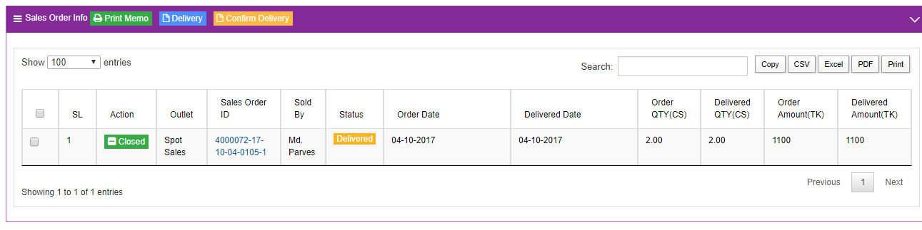
Spot sales Show in Server:
After Send /Data sync from Mobile, Spot Sale will show in Other’s order as Confirm Order [Order Delivered]

Slide 16
End
Thank You

